Slide 1
PharmaGuard AI
EXPLAINABLE AI-BASED PHARMACOVIGILANCE SIGNAL DETECTION & ADVERSE EVENT RISK PRIORITIZATION
CAPSTONE PROJECT
Presented By:
1. Student Name- Cathrin rabaca
2. College Name-Cheran college of pharmacy
3. Department- Bachelor of pharmacy
4. AICTE ID-STU6a2ce4e50bb6f1781327077

Slide 2
OUTLINE
Problem Statement (Should not include solution)
Proposed System/Solution
System Development Approach (Technology Used)
Algorithm & Deployment
Result
Conclusion
Future Scope
References

Slide 3
PROBLEM STATEMENT
Adverse Drug Event (ADE) reports pile up in FDA's FAERS database by the hundreds of thousands every year, but review of these reports for fatality risk is still largely manual and reactive. Pharmacovigilance teams cannot easily prioritize which incoming case reports carry a genuinely high risk of a fatal outcome among thousands of reports. Existing dashboards typically show only raw report counts, not a calibrated risk score or the reasons behind it. There is no single accessible tool that combines fatality-risk prediction with a plain-language explanation of "why" a case is risky, alongside drug-reaction signal detection.

Slide 4
PROPOSED SOLUTION
PharmaGuard AI is an explainable pharmacovigilance assistant that predicts the fatality risk of an adverse drug event report and explains the prediction in plain language, turning raw FAERS data into actionable safety insight. It consists of:
Data Source: FDA FAERS historical data, 2015–2026 (528,000+ reports), covering patient demographics, drug counts, reaction counts, and report metadata.
Risk Prediction Model: A RandomForest classifier predicts Fatal vs Non-Fatal outcome probability and assigns a Risk Level and Severity Tier for every report.
Explainability Engine: SHAP values show exactly which features pushed fatal risk up or down for each case, with a plain-English summary.
Signal Detection: A PRR/ROR table flags over 20,000 statistically unusual drug–reaction combinations from real FAERS data.
Risk Heatmap: Visualizes fatal rate across Age Group × Drug-Count, exposing high-risk patient segments at a glance.
Deployment: A Streamlit web app with Overview, Predict Risk, Signal Detection, and Risk Heatmap tabs, deployable free via GitHub + Streamlit Community Cloud, with a downloadable PDF report for every prediction.

Slide 5
SYSTEM APPROACH
System requirements:
Python 3.x runtime environment
Historical FAERS data (2015–2026) for training the model
Minimum 8 GB RAM (for training RandomForest on 500k+ records)
Web browser (Chrome/Edge) to access the Streamlit interface
Internet connection for cloud deployment and model updates
Windows/Mac/Linux OS — cross-platform compatible

Slide 6
ALGORITHM & DEPLOYMENT
Algorithm Selection: Three models were benchmarked with 5-fold cross-validation — Logistic Regression (0.7499 ROC-AUC), Gradient Boosting (0.8118), and RandomForest (0.8128, lowest variance). RandomForest was selected for its best balance of accuracy, stability, and native compatibility with SHAP's TreeExplainer.
Data Input: 12 features per report — num_reactions, num_drugs, patient_age_years, patient_weight_kg, report_age_days, month, year, age_group, patient_sex, drug_count_category, country, and seriousness flag.
Training Process: Trained on FAERS reports (2015–2026) with a train/test split, then serialized with joblib for reuse in the app.
Prediction Process: A user enters report details in the Predict Risk tab; the pipeline instantly returns Fatal/Non-Fatal probabilities, Risk Level, Severity Tier, and a SHAP-based explanation.
Deployment: SHAP's TreeExplainer runs in tree_path_dependent mode with no background data, avoiding memory-mapped temp-file errors on Windows/OneDrive paths, while Streamlit's @st.cache_resource keeps the explainer loaded across reruns. The app is deployed free via GitHub + Streamlit Community Cloud

Slide 7
RESULT
Dataset: 528,000 FAERS reports (2015–2026) — 10.3% fatal, 74.8% serious, 35.6% hospitalized. US contributes the largest report volume, followed by Canada and Japan.
Model comparison (5-fold CV ROC-AUC): Logistic Regression 0.7499, Gradient Boosting 0.8118, RandomForest 0.8128 (selected — best accuracy with lowest variance). Final held-out performance: ROC-AUC 0.8117, Accuracy 67.58%, weighted F1 0.7393.
SHAP analysis shows patient_sex and age_group as the strongest drivers that increase predicted fatal risk, while drug_count_category (polypharmacy) and report_age_days tend to reduce it.
Risk Heatmap: fatal rate rises from 13% (Infant) to 23% (Elderly 81+) with age; highest-risk cell overall is Adult(19–40) × Unknown drug-count at 37.5%. By sex: Male 13%, Unknown 11%, Female 8%.
Signal Detection flags 20,047 drug–reaction pairs by PRR/ROR (e.g., BCG Live → Bladder carcinoma, Propofol → Propofol infusion syndrome among top signals).
Sample case: a 66-year-old (Senior) patient on 7 drugs with 6 reactions was predicted Non-Fatal (58.6%) vs Fatal (41.4%), still flagged HIGH RISK / Life-Threatening — showing the system catches borderline danger, not just clear-cut fatalities.

Slide 8
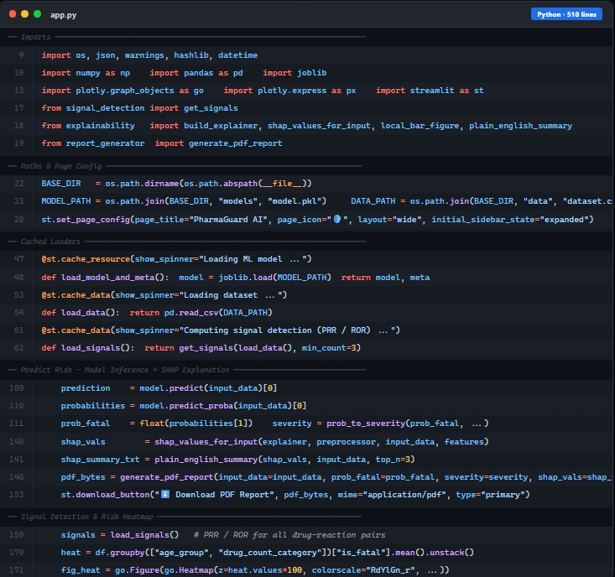

Slide 9
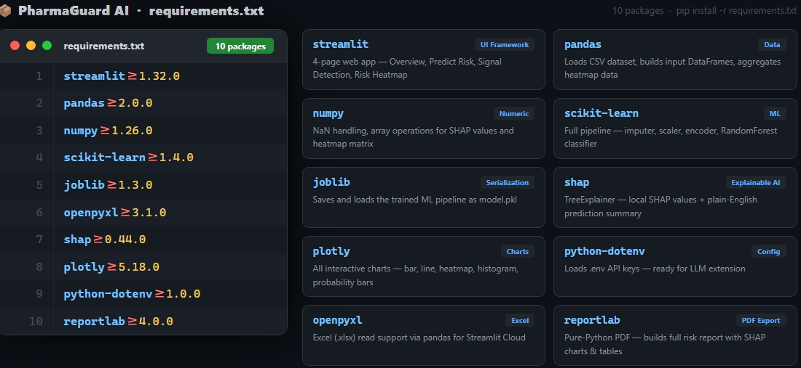

Slide 10
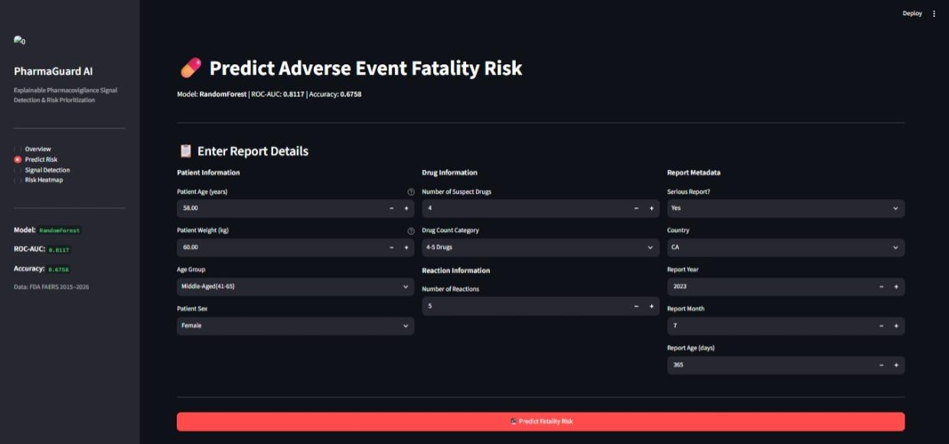

Slide 11
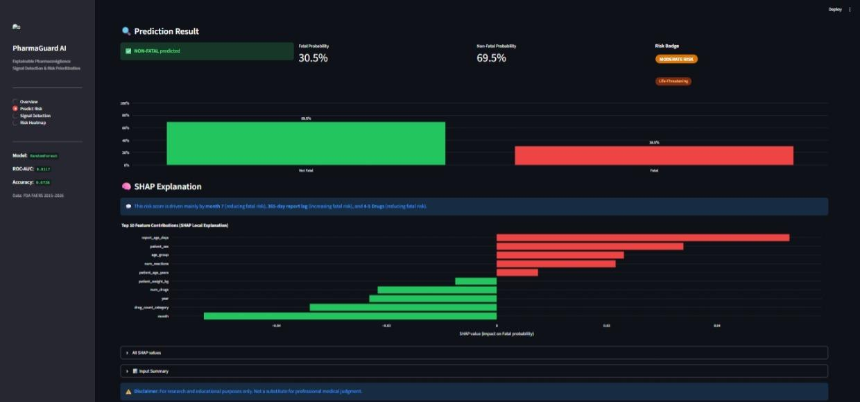

Slide 12
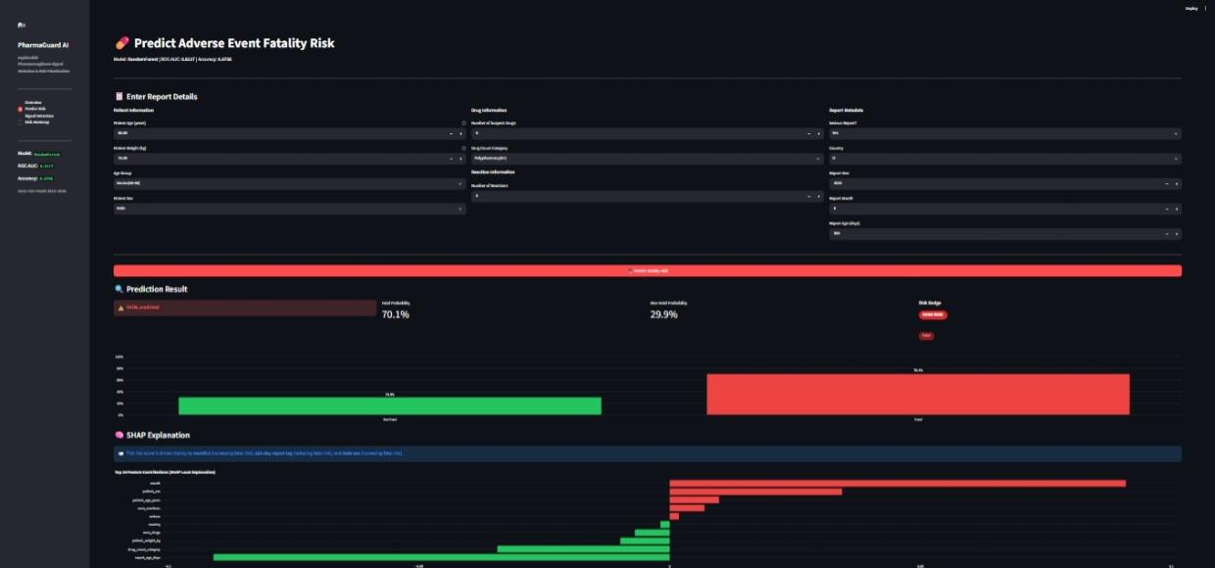

Slide 13
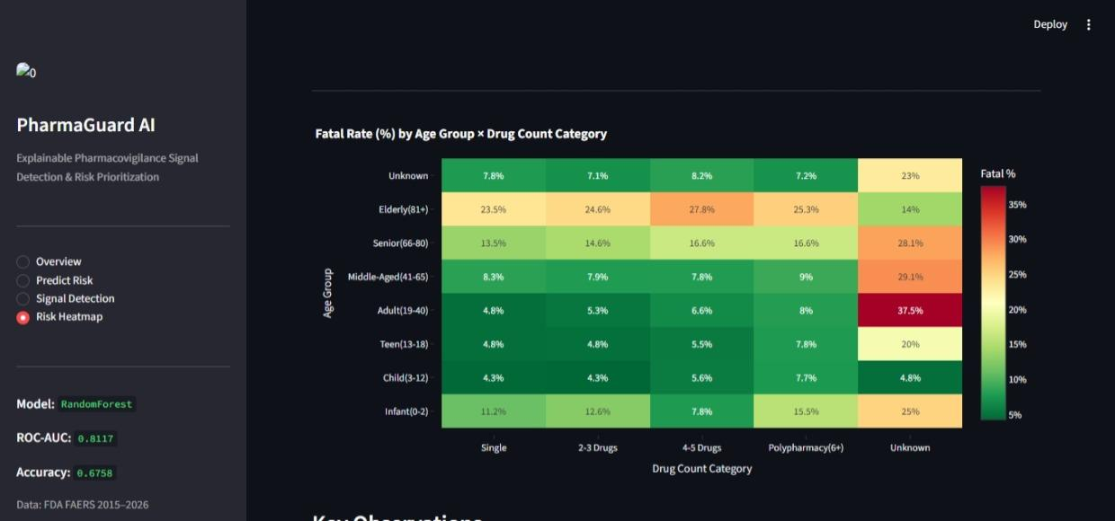

Slide 14
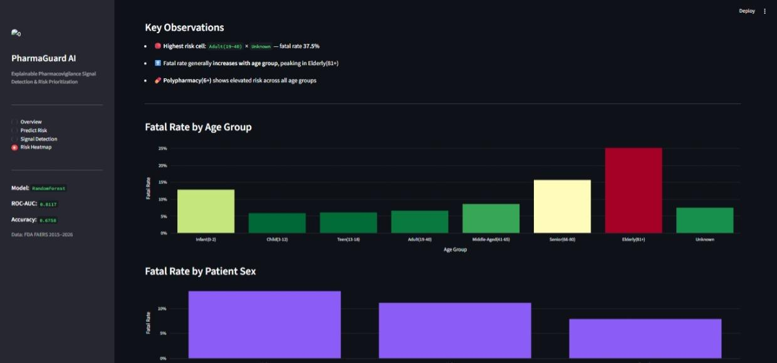

Slide 15
CONCLUSION
PharmaGuard AI proves that spontaneous FAERS reports can be turned into an interpretable, deployable fatality-risk screening tool (ROC-AUC 0.81) that explains its own reasoning through SHAP, surfaces hidden drug-safety signals via PRR/ROR, and visualizes risk hotspots through a heatmap — all inside one lightweight Streamlit app.
Key challenges overcome:
SHAP's default Independent masker caused [Errno 22] errors on Windows OneDrive paths — fixed by switching TreeExplainer to tree_path_dependent mode, which needs no background data and runs fully in-memory.
Streamlit's cache held a stale, broken explainer object across code changes — fixed by rebuilding the cache cleanly on restart.
Improvement scope: current accuracy (67.6%) leaves room for richer features and additional models before any real-world pharmacovigilance use.

Slide 16
FUTURE SCOPE
Add and compare more models (XGBoost, Logistic Regression) with a model-selection dropdown.
Add drug-name search and autocomplete for faster case lookup.
Add a login/authentication page for multi-user, role-based access.
Expand beyond the current single-country field to global regulatory sources (EMA, WHO VigiBase).
Automate retraining on new FAERS quarterly releases, with email/PDF alerts for newly detected high-risk signals.

Slide 17
REFERENCES
FDA FAERS Public Dashboard — adverse event report data, 2015–2026
Lundberg and Lee, A Unified Approach to Interpreting Model Predictions, SHAP, NeurIPS 2017
Breiman, L., Random Forests, Machine Learning, 2001
scikit-learn documentation — RandomForestClassifier
Streamlit documentation
ReportLab documentation — PDF generation library
GitHub

Slide 18
DEPLOYMENT LINK / GITHUB LINK
GithubLink:https://github.com/Cathrinrabaca/PharmaGuard-AI-Explainable-AI-Based-Pharmacovigilance-.git
Deployment: HF, Streamlit Link, Gradio (OPTIONAL)
Streamlit: https://o45ui9fsfwsltdd5saj5jf.streamlit.app/

Slide 19
THANK YOU

